Slide 1
Respiration in Cells

Slide 2
By the end of this Smart Lesson you should be able to:
1. | Describe the process and write an equation for cellular respiration.
2. | Explain how changing energy needs affect respiration.

Slide 3

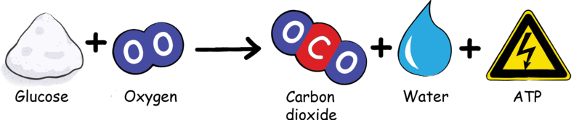
What is cellular respiration?
Cellular respiration is one of the main ways in which cells gain energy to fuel their cellular activity.
The chemical equation for respiration is:

Slide 4
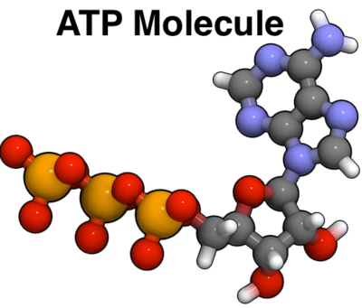
Energy in our bodies is stored as ATP.
The energy is stored in a molecule called ATP, which can then be used to provide energy to other parts of the cell.

Slide 5
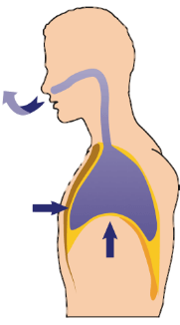
This process produces carbon dioxide, a waste product, which must be expelled.
This is done through exhalation.

Slide 6
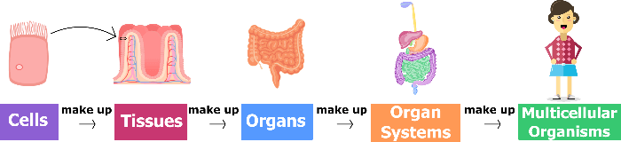
Why exactly do our cells need energy?
Our cells need energy to do work.
Therefore, oxygen is essential so that our cells that make up our tissues, organs, organ systems and bodies can do their jobs!

Slide 7
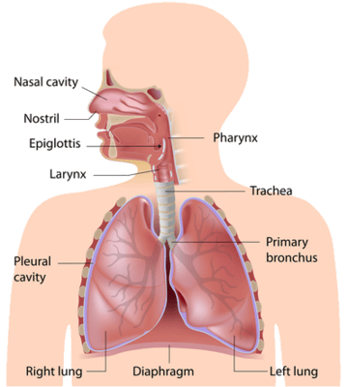
Breathing and energy.
If the amount of energy we use changes, our respiratory system must adjust so that our cells can continue to produce enough energy.

Slide 8
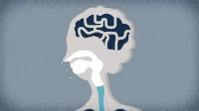
Our respiratory system adjusts to changing energy requirements by adjusting our breathing rate.

Slide 9

Changing energy needs will affect respiration.
For example, during exercise, where our cells require a lot of energy, our breathing rate increases, so that each cell gets more oxygen and can make more energy.

Slide 10

Changing energy needs will affect Respiration II
In contrast, if our energy requirements decrease, such as when we are sleeping, our breathing rate decreases, so that each cell gets just enough oxygen to make the energy required and no more.

